Slide 1
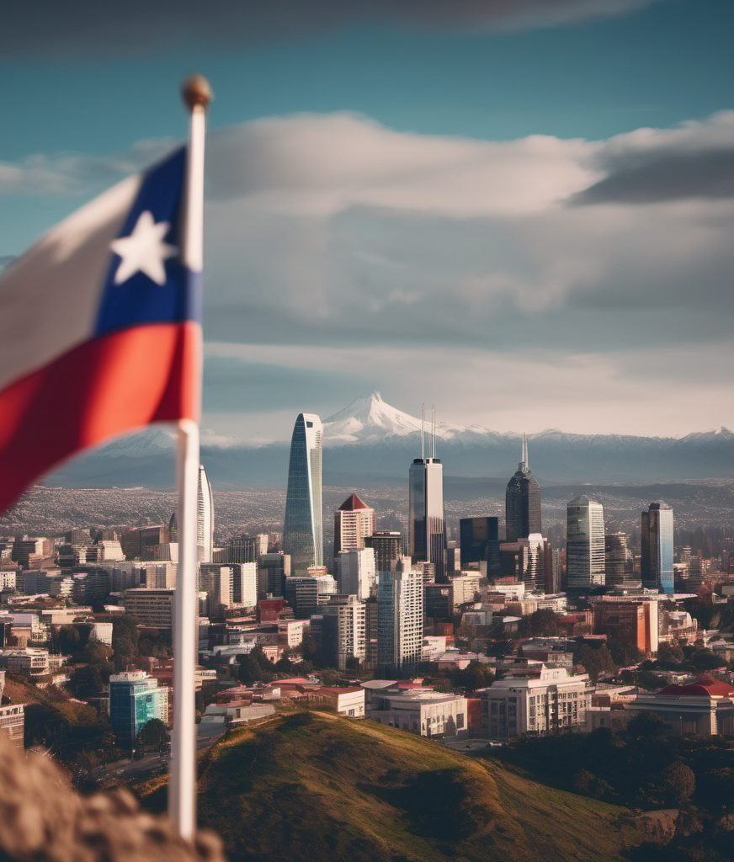
Apparel Operations:
A Step Forward in Chile
Presentation by:
1. Nagarjuna Reddy Sreerangapu
2. Shiva Siddharth Yedla
3. Sasi Kumar Karumuri
4. Sathvik Reddy Kommidi
5. Narenndra Bhasuru

Slide 2

BACKGROUND
Our company is considering expanding to a new country. We've been tasked with analyzing the country's economic conditions to see if it's a good fit for our apparel business.

Slide 3

Problem Statement
We will cover these topics
Determine the economic viability of a specific country for our apparel MNC's expansion.
Evaluate the country's economic conditions to understand if it presents a favorable environment for our business.

Slide 4


DATA
OUR DATA SOURCES
World Bank databases
International Monetary Fund (IMF) reports
HDX
Statista
Industry reports and research studies
DATA STATISTICS
Data has been analyzed and cleaned according to the requirements
GDP comparison has been reduced to only selected countries for the PACIFIC ALLIANCE group.
Data with years had been redacted to required amount of years of required of last 10 years

Slide 5

ANALYSIS
Our analysis shows that the country has a stable economy with a steady GDP growth rate, low inflation, and moderate population growth. The low unemployment rate and high per capita income suggest a potential market for our apparel products.

Slide 6
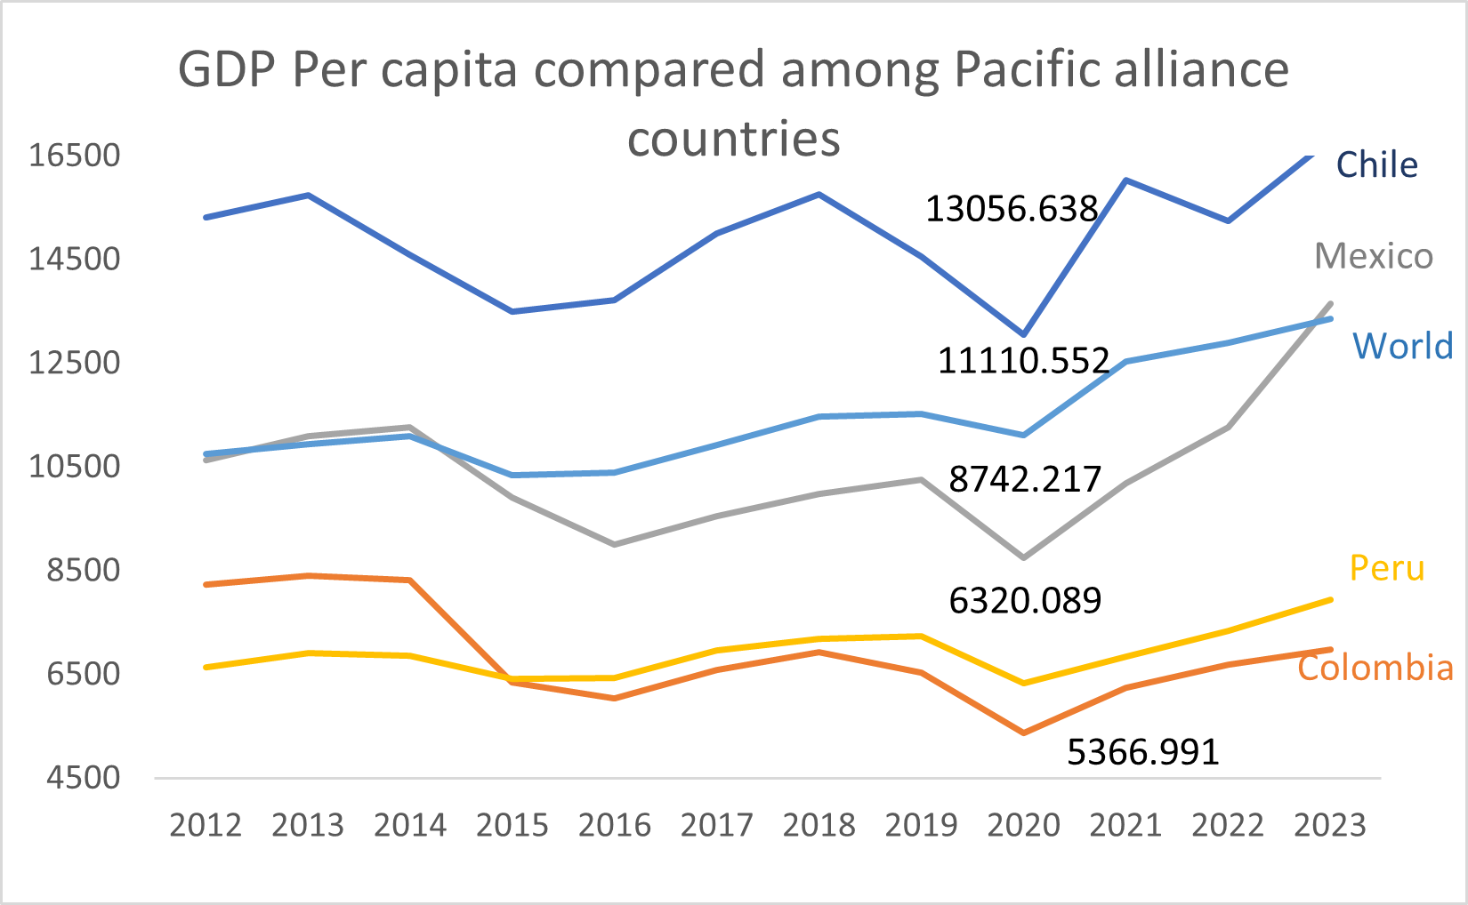
CHILE GDP COMPARISION TO OTHER COUNTRIES
Slide showcases Pacific Alliance countries' GDP per capita (2012-2023), valuable for high-end apparel MNC expansion.
Chile and Mexico have higher GDP per capita, meaning larger markets for luxury apparel.
Colombia and Peru with lower GDP per capita could be ideal for affordable apparel segments, enabling strategic market entry.
6

Slide 7
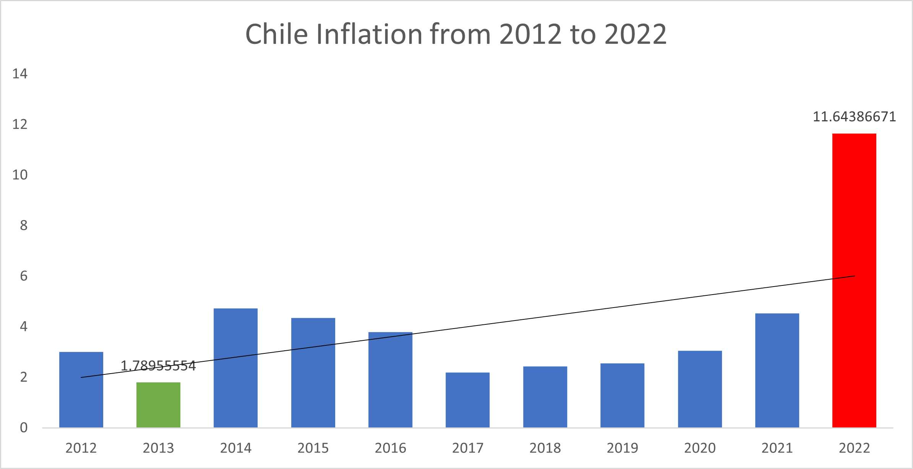
CHILE INFLATION RATE
Chile's inflation rate surged from 2012 to 2022, as shown on this slide.
To expand successfully, apparel companies must monitor inflation trends in target markets.
Despite the recent inflation drop, Chile remains appealing for expansion, but further economic analysis is needed.
7

Slide 8
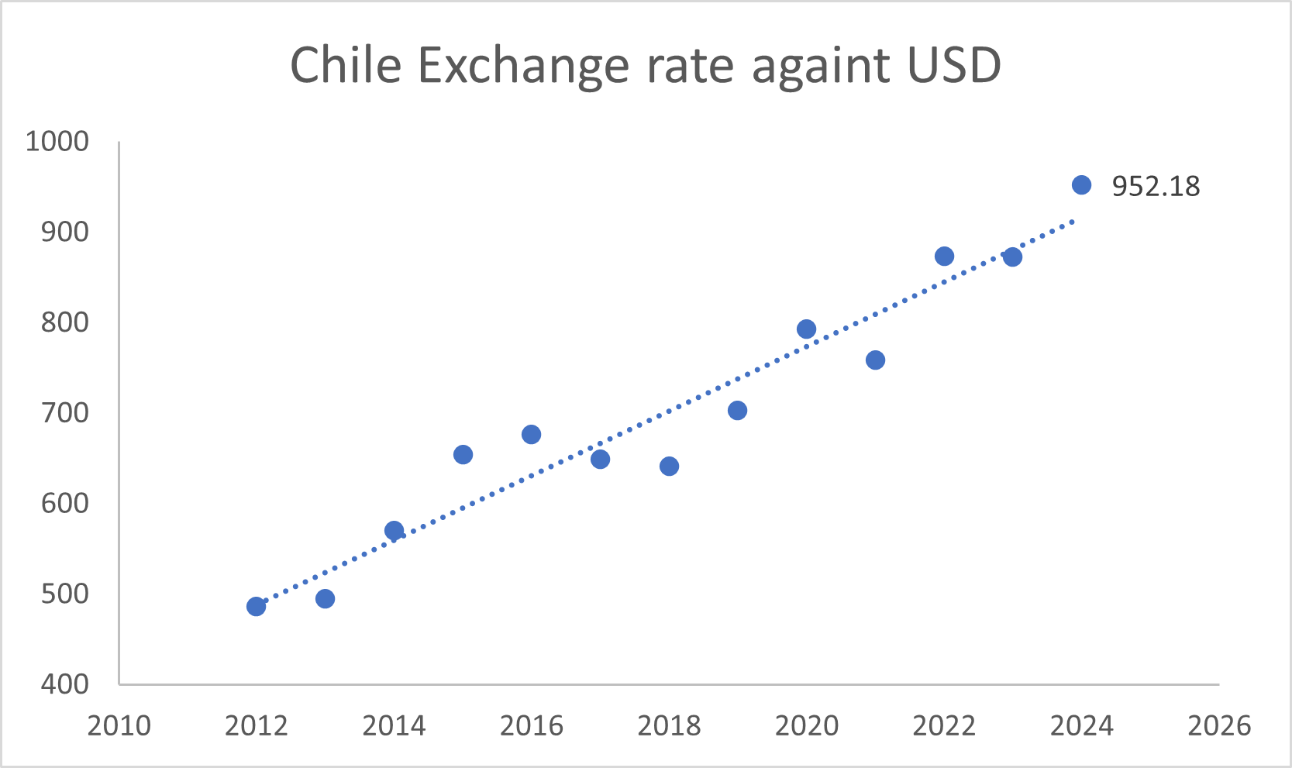
CHILE EXCHANGE RATE
This slide shows the exchange rate trend of CLP to USD from 2010 to 2026, with the current rate at 952.18 CLP per USD.
The data provides the exchange rate history between CLP and USD, which is crucial for our Chile expansion strategy.
Understanding currency trends is essential to plan our expansion into Chile and mitigate potential business impacts.
8

Slide 9
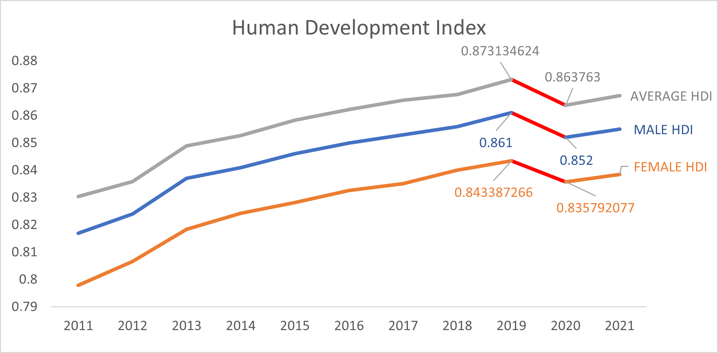
CHILE HUMAN DEVELOPMENT INDEX
HDI measures overall well-being and development in a country.
Company's primary regions have HDI of
0.80-0.88, indicating High development.
Evaluating HDI helps understand workforce, infrastructure, and business environment in new territories.
9

Slide 10
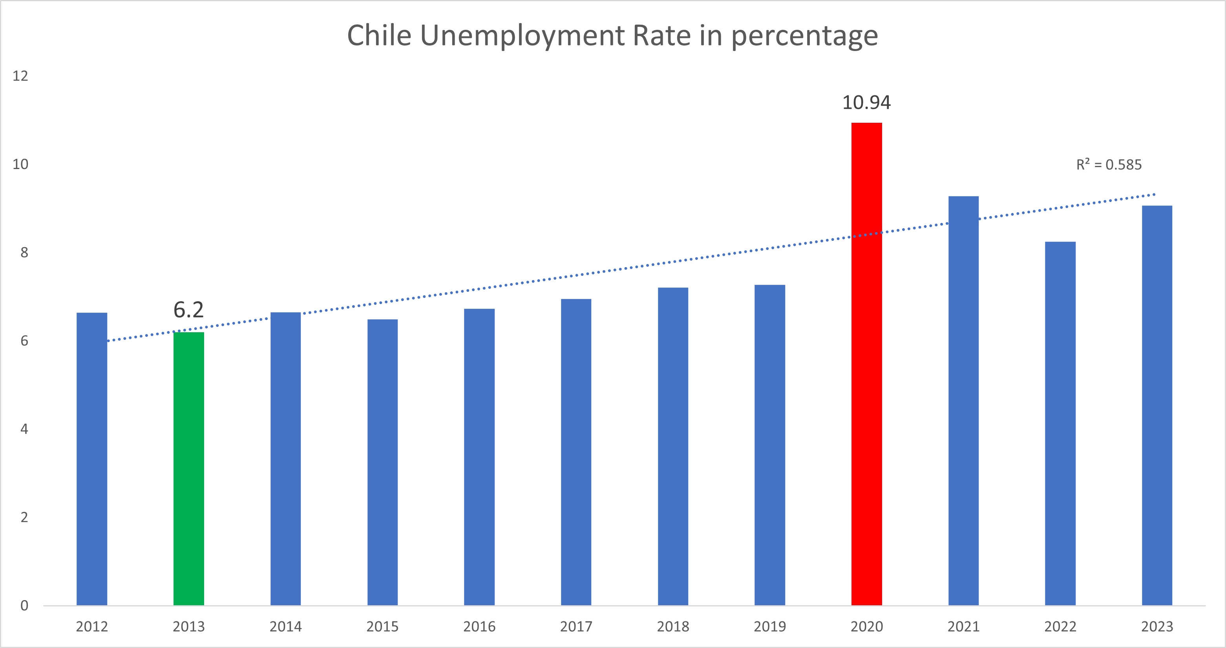
CHILE UNEMPLOYMENT RATE
Slide shows Chile's unemployment rate (2012-2023).
Data exhibits declining trend, with a 2020 uptick.
Understanding economic indicators, like unemployment, is vital for informed MNC apparel industry decisions.
10

Slide 11
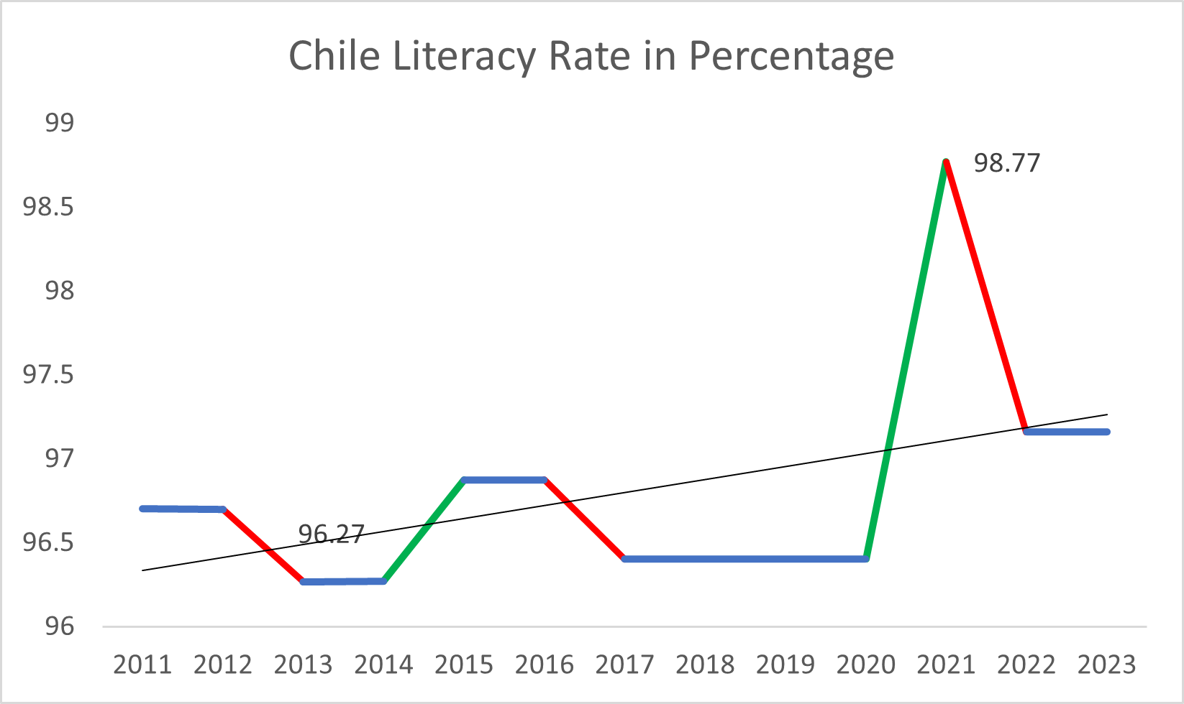
CHILE LITERACY RATE
Chile has a high and improving literacy rate.
Long-term data shows commitment to education.
A skilled workforce is indicated by the high literacy rate.
11

Slide 12
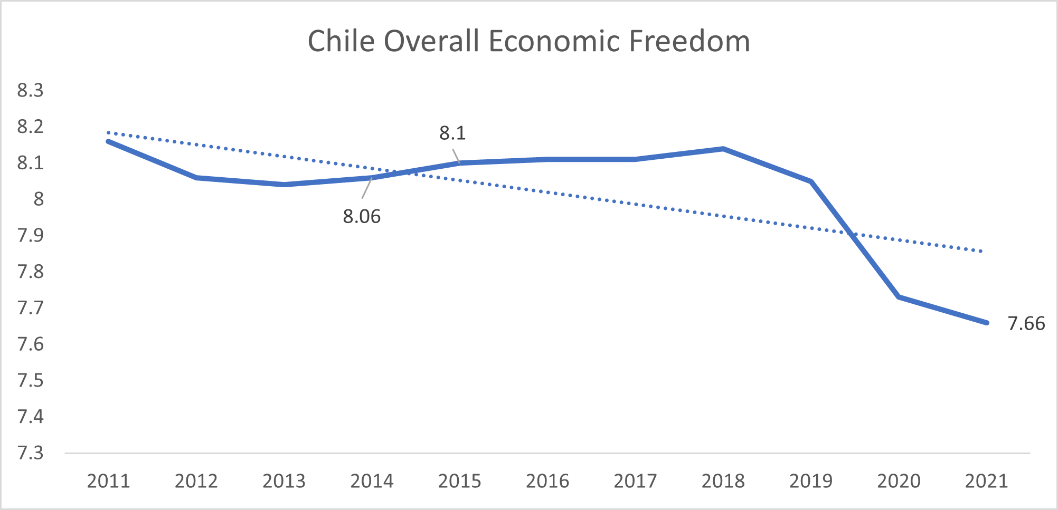
CHILE ECONOMIC FREEDOM
Chile's Overall Economic Freedom (2011-2021) has been high, averaging 7.66.
Chile scored 8.3 in 2011-2012, indicating a stable and favorable business climate.
Despite fluctuations, Chile's Overall Economic Freedom remained above 7.3, even in 2020-2021, showing resilience and stability.
12

Slide 13
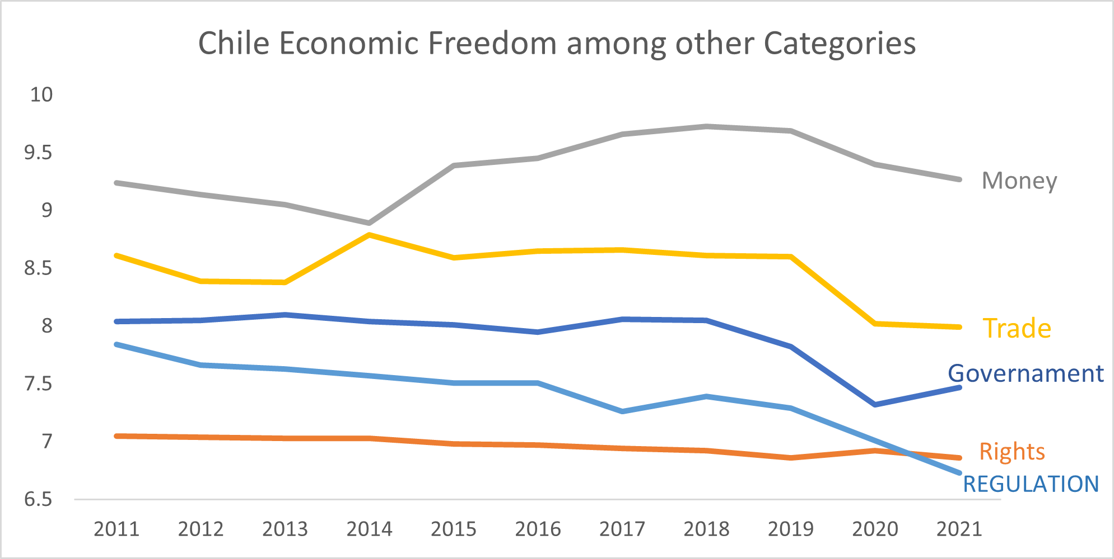
CHILE ECONOMIC FREEDOM IN DIFFERENT CATEGORIES
Chile's economic freedom scores have been stable with recent improvements.
High scores in money, trade, and government categories indicate a favorable business environment.
Chile's economic freedom profile is a positive factor when evaluating new territories for expansion.
13

Slide 14
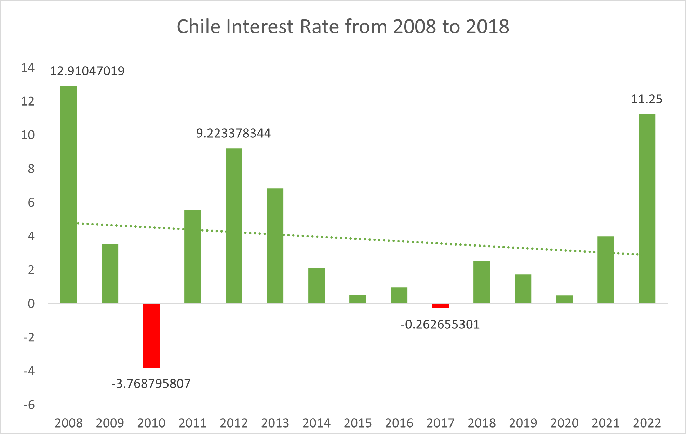
CHILE INTEREST RATE
Chile's interest rate has fluctuated over the past decade, reaching 11.25% in 2022.
Interest rate trends are an important consideration for our company when evaluating potential markets.
Changes in interest rates can impact borrowing costs and financing expenses for our business.
14

Slide 15

FINDINGS
GDP per capita: Chile has a relatively high GDP per capita compared to other countries in the region, indicating a strong economy.
Inflation rate: The inflation rate in Chile has been relatively stable, with a slight increase in recent years.
Exchange rate: The Chilean Peso has fluctuated against the US Dollar, but the overall trend has been stable.
HDI: Chile has a high HDI score, indicating a high standard of living, well-developed infrastructure, and a well-educated population.
Unemployment rate: The unemployment rate in Chile has been decreasing, with a slight increase in 2020, suggesting a strong labor market.
Literacy rate: Chile has a high literacy rate, indicating a well-educated population.
Economic Freedom: Chile consistently ranks high in economic freedom, indicating a favorable business environment.
Interest rate: The interest rate in Chile has fluctuated from 2012 to 2014, but it has remained relatively low, which could benefit borrowing costs and financing expenses.

Slide 16

RECOMMENDATION
What we’ve learned so far
Expanding operations in Chile is advisable due to its strong economy, stable inflation rate, and favorable business environment.
Chile's well-educated population is a positive factor for potential expansion.
Monitor exchange rate fluctuations to maintain financial stability.
Keep an eye on interest rate changes to manage borrowing costs and financing expenses.
Continuous monitoring of economic conditions and potential risks is crucial for long-term success in the new territory.

Slide 17

Thank you

